Slide 1

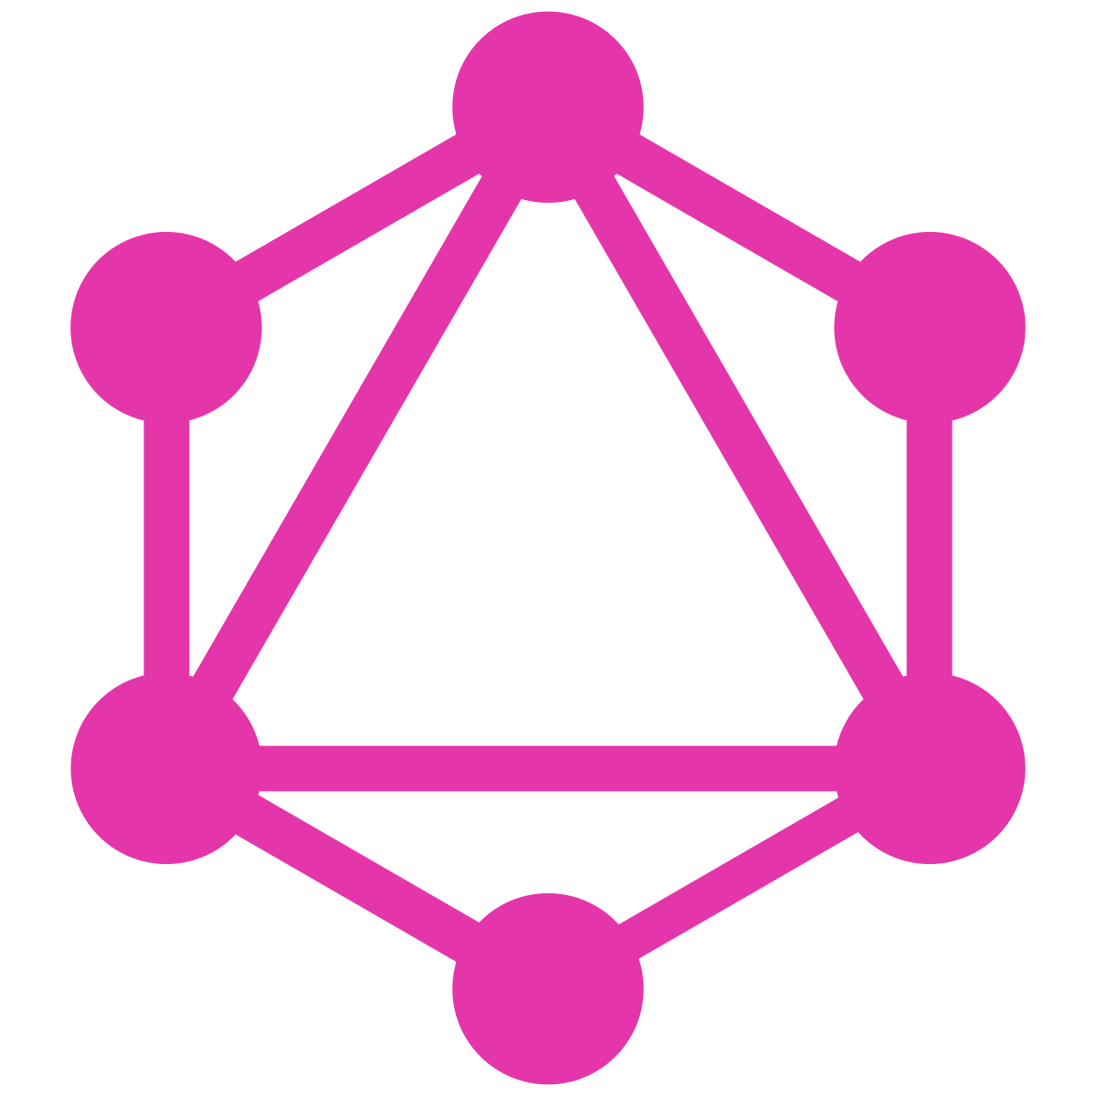


GraphQL & Ruby
Pablo Aizpiri Software Engineer at GoCo

Slide 2

& GraphQL
RoR, PosgreSQL, React/Relay
Like most companies, originally had REST endpoints
Pain points:
Over-fetching (wide endpoints)
Under-fetching (multiple round trips or custom endpoints)
Switched in 2016 (very early adopter)
Graph build once, client can construct queries however necessary.
Bugs decreased, productivity and dev happiness increased :)

Slide 3
GraphQL
A query language for APIs and a runtime for fulfilling those queries with your existing data
Developed internally by Facebook in 2012, publicly release in 2015
Efficient, powerful, and flexible
Ask only for what you need; lightweight & efficient
Type introspection
Strongly Typed
Flexible/Rich Schemas

Slide 4
Thanks! Questions?
Resources:
Github Demo Repo: https://github.com/JhottMaster/GraphQLDemo
GraphQL Official Site: https://www.graphql.com/
GraphQL spec: https://graphql.github.io/graphql-spec/June2018/

